Slide 1

Data Structures in Python

Slide 2

Agenda
Introduction to Dynamic Programming
Concept of overlapping subproblems
Memoization (Top-Down approach)
Tabulation (Bottom-Up approach)
Comparison of Memoization and Tabulation
Practice examples

Slide 5
Unit Overview
This unit introduces Dynamic Programming (DP), an important problem-solving technique used to optimize recursive solutions by storing previously computed results. Students will learn how DP improves performance by avoiding repeated calculations.
The unit covers two main approaches: Memoization (Top-Down) and Tabulation (Bottom-Up). These techniques help solve complex problems efficiently and are widely used in optimization and algorithm design.
Dynamic Programming is commonly used in problems like Fibonacci, shortest path, and optimization problems.

Slide 6
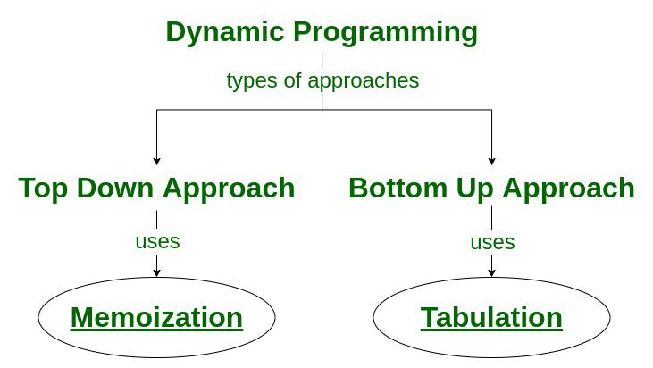
Introduction to Dynamic Programming
Dynamic Programming (DP) is a technique used to solve problems by breaking them into smaller subproblems and storing their results to avoid repeated calculations.
DP improves efficiency by saving previously computed values.

Slide 7
Why Dynamic Programming?
Some problems repeat the same calculations many times.
Example: Fibonacci
Normal recursion:
F(5)
├── F(4)
│ ├── F(3)
│ │ ├── F(2)
│ │ └── F(1)
│ └── F(2)
└── F(3)
├── F(2)
└── F(1)
Here F(3) and F(2) are calculated multiple times.
DP solves this problem by storing results.

Slide 8
Key Concepts of DP
Two important properties:
1. Overlapping Subproblems
Same problem solved multiple times.
Example:
F(3) calculated again and again.
2. Optimal Substructure
Optimal solution can be built from optimal subproblems.
Example:
F(n) = F(n−1) + F(n−2)

Slide 9
Key Concepts of DP
Fibonacci Problem Example
Fibonacci sequence:
0, 1, 1, 2, 3, 5, 8, 13
Formula:
F(n) = F(n−1) + F(n−2)

Slide 10
Key Concepts of DP
Recursive Solution (Without DP)
Python example:
def fibonacci(n):
if n <= 1:
return n
return fibonacci(n-1) + fibonacci(n-2)
print(fibonacci(5))
Output:
5
Problem with Recursion
Time Complexity:
O(2^n)
Very slow for large n.

Slide 11
Memoization (Top-Down Approach)
Memoization stores results of function calls and reuses them when needed.
Avoids repeated calculations.
How Memoization Works
Step 1: Check if result already exists Step 2: If yes → return result Step 3: If no → calculate and store

Slide 12
Memoization (Top-Down Approach)
Memoization Visualization
memo = {
0:0,
1:1,
2:1,
3:2,
4:3,
5:5,
6:8
}
Stored values reused.
Time Complexity
O(n)
Much faster than recursion.

Slide 13
Tabulation (Bottom-Up Approach)
Tabulation solves problem from bottom and stores results in table.
Starts from smallest value.
How Tabulation Works
Step 1: Create table Step 2: Fill values from beginning Step 3: Use stored values
Table Visualization
Index: 0 1 2 3 4 5 6
Value: 0 1 1 2 3 5 8
Time Complexity
O(n)

Slide 14
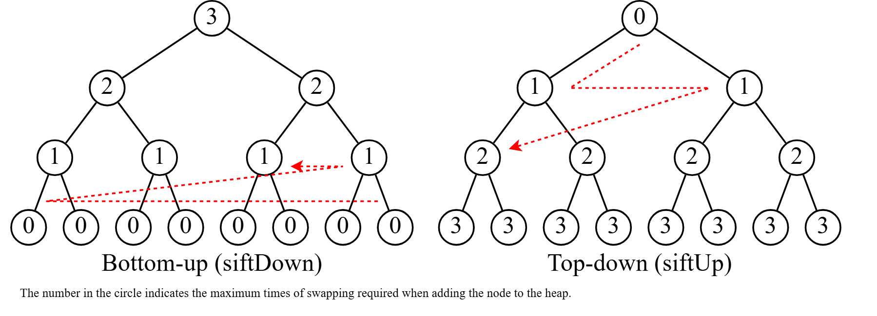

Slide 15
Real-World Applications
Dynamic Programming used in:
Shortest path algorithms
Google Maps
Resource optimization
Game development
Robot navigation

Slide 16
Example Problem
You can climb 1 or 2 steps.
Find number of ways to reach step n.
Example:
n = 4
Ways:
1+1+1+1
1+1+2
1+2+1
2+1+1
2+2
Answer = 5

Slide 17
Key Outcomes
Understand Dynamic Programming concept
Identify problems that use DP
Implement Memoization approach
Implement Tabulation approach
Optimize recursive solutions using DP
Solve basic problems using Dynamic Programming

Slide 18
Thank You!

